Slide 1
Art Project
.
BY AVANISH MURKUTE
CLASS 6TH b
ROLL NO.12

Slide 2
Topic-Warli Painting
From Maharastra

Slide 3
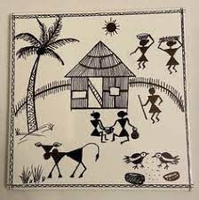
What is Warli Painting?
Ans-Warli is a traditional art form of Maharashtra. These paintings are distinctive with their vivid contrast expressions. These paintings are mainly dominated by basic geometric shapes like circles, triangles and squares. These geometric shapes stand as a symbol of natural elements in our environment.

Slide 4
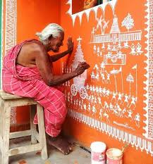
What is special about Warli Painting?
Ans-
Warli painting is simple and linear, with maximum use of triangular shapes. They draw inspiration from every life for their themes. The most important aspect of the painting is that it does not depict mythological characters or images of deities, but social life.

Slide 5
What is the history of Warli Painting?
The Warli tribe is one of the largest in India, located outside Mumbai. Till the 1970s, even though the tribal style of art is thought to date back as early as 10th century C.E. The Warli culture is centered on the concept of Mother Nature and elements of nature are often focal points depicted in Warli Painting.

Slide 6
What are the symbols of Warli Painting?
These rudimentary wall paintings use a set of basic geometric shapes: a circle, a triangle, and a square. These shapes are symbolic of different elements of nature. The circle and the triangle come from their observation of nature.

Slide 7
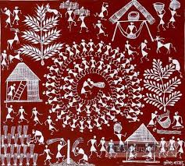
Which is the main color used in Warli Painting?
The Warli exclusively use a white pigment made from a mixture of rice flour and water mixed with gum, which is then applieIf you ask how old warli art is, then the origin of Warali art can be traced back to around 3000 BC and seems to have an enigmatic appeal to it. Even though the tribal art style dates back to the 10th century A.D., the Warli paintings form was not known until the 1970s.d to the wall using a bamboo stick chewed at one end to make a supple paint brush.

Slide 8
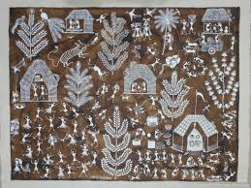
How old is Warli Art?
If you ask how old warli art is, then the origin of Warli art can be traced back to around 3000 BC and seems to have an enigmatic appeal to it. Even though the tribal art style dates back to the 10th century A.D., the Warli paintings form was not known until the 1970s.

Slide 9
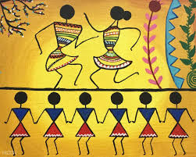
Which caste is Warli Art?
The Warli or Varli are an indigenous tribe (Adivasi) of western India, living in mountainous as well as coastal areas along the Maharashtra-Gujarat border and surrounding areas. They have their own animistic beliefs, life, customs and traditions, and as a result of acculturation they have adopted many Hindu beliefs.

Slide 10
Thank You

